Slide 1
SADBHAVNA COLLEGE OF EDUCATION FOR WOMEN
RAIKOT , JALALDIWAL, LUDHIANA

Slide 2
TOPIC
Principal
of
Teaching

Slide 3
Principles of Teaching
Teaching is a complex social and cultural phenomenon. It is not as easy to tech as it appears. While teaching, a teacher has to keep in mind the aims and objectives of his subject, needs, interests of his pupils, the environmental situations suitable for them etc. Success of this profession depends upon good planning and mastery in the subject to be taught. Hence for helping the teacher,some principles have been designed on the basis of general experiences, traditions and researches.

Slide 4
These principles proide guidelines to the teacher as to what methods should be adopted in the class room to increase the teaching efficiency.

Slide 6
General Principles

Slide 7
Principle of Definite Objectives Principle of Selection of Material

Slide 8
Principle of Model Presentation

Slide 9
Principle of Gradation Principle of Activity

Slide 10
Principle of Correlation

Slide 11
Principle of child centredness

Slide 12
Principle of co- operation

Slide 13
Principle of planning

Slide 14
Principle of individual differences

Slide 15
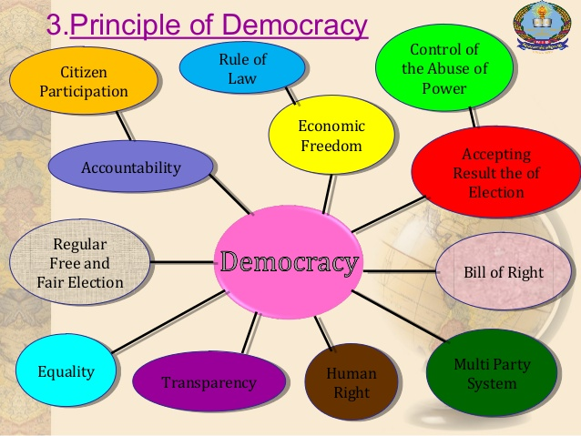
Principle of Democracy
Principle of Progressivism

Slide 16
Principle of Self-reliance and Self confidence

Slide 17
THANKS

